Slide 1
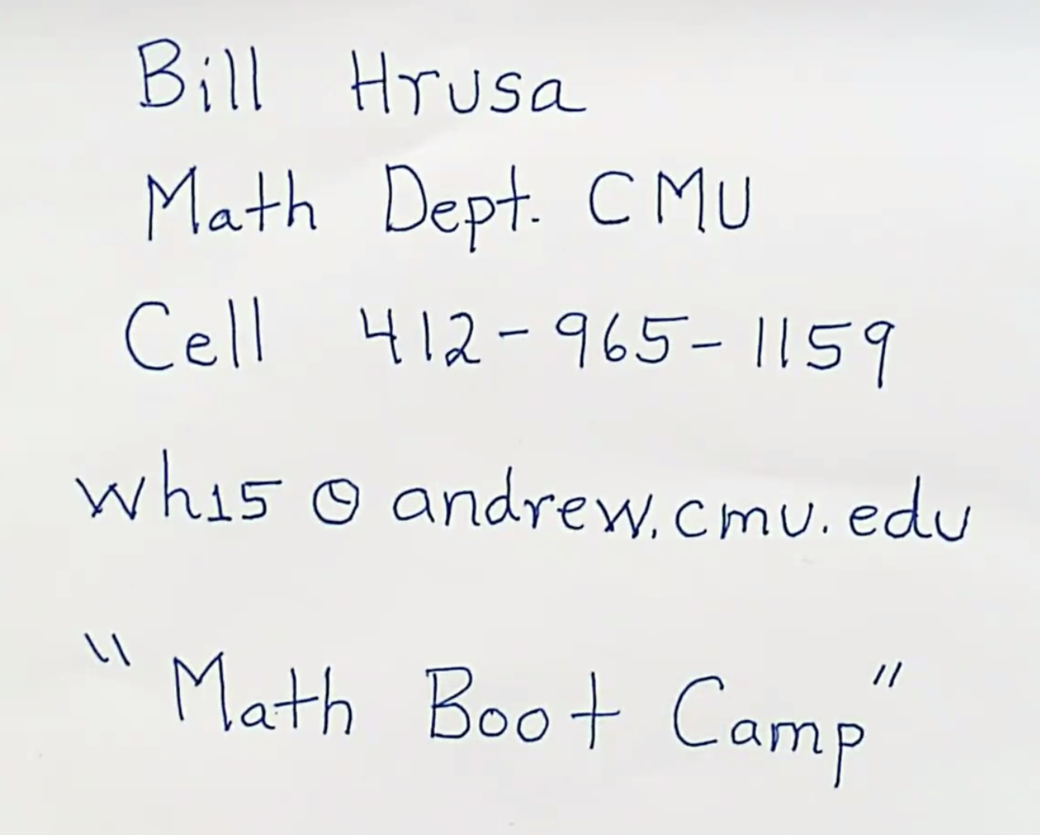

Slide 2
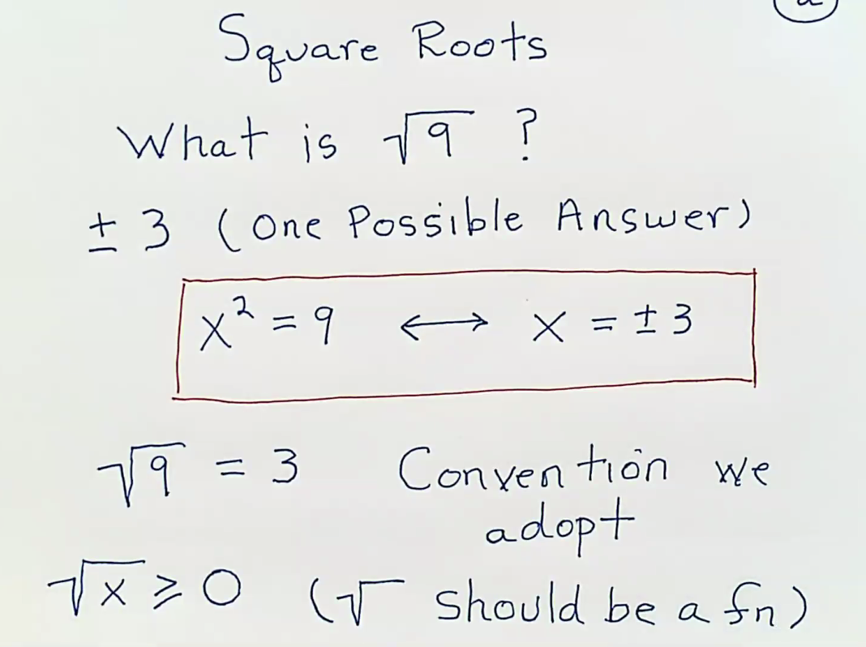
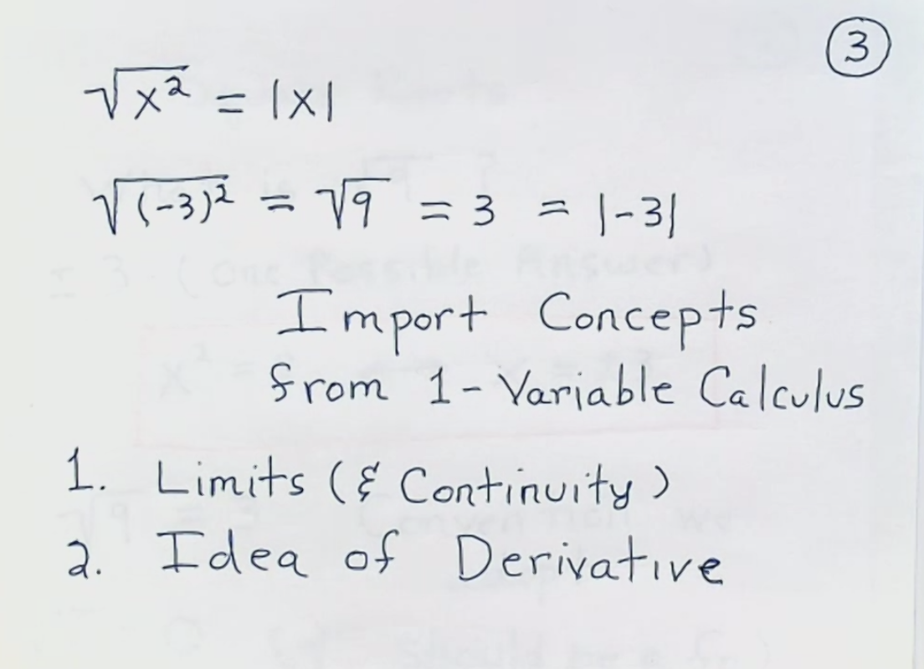

Slide 3
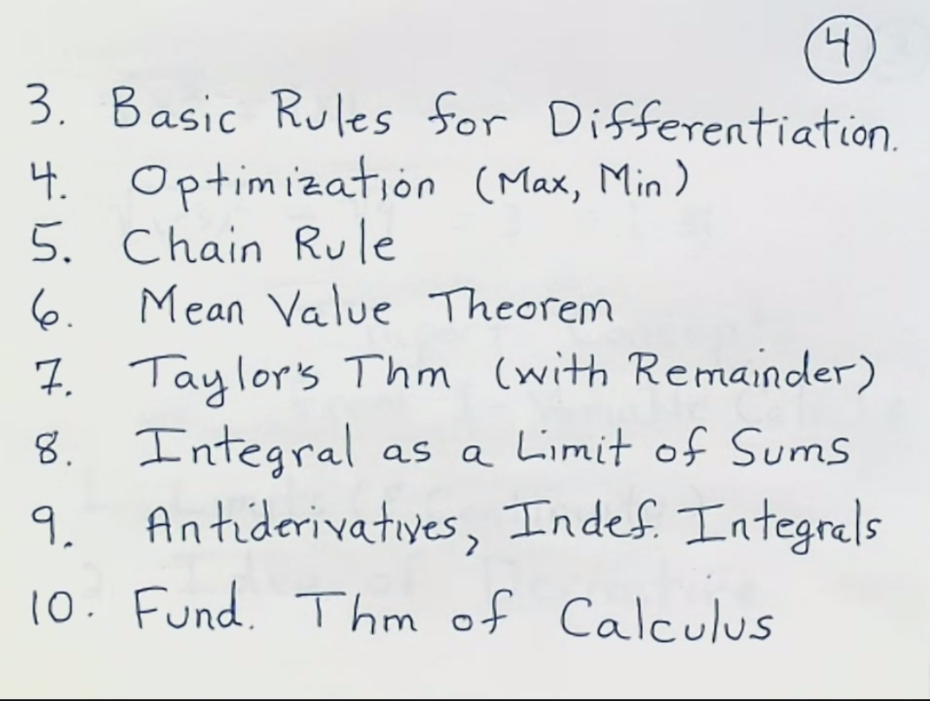
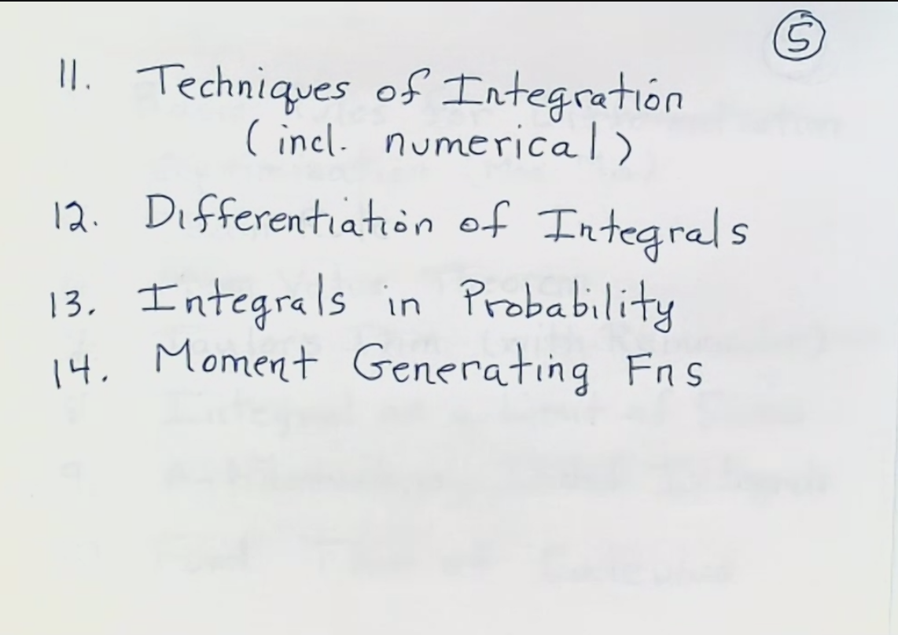

Slide 4
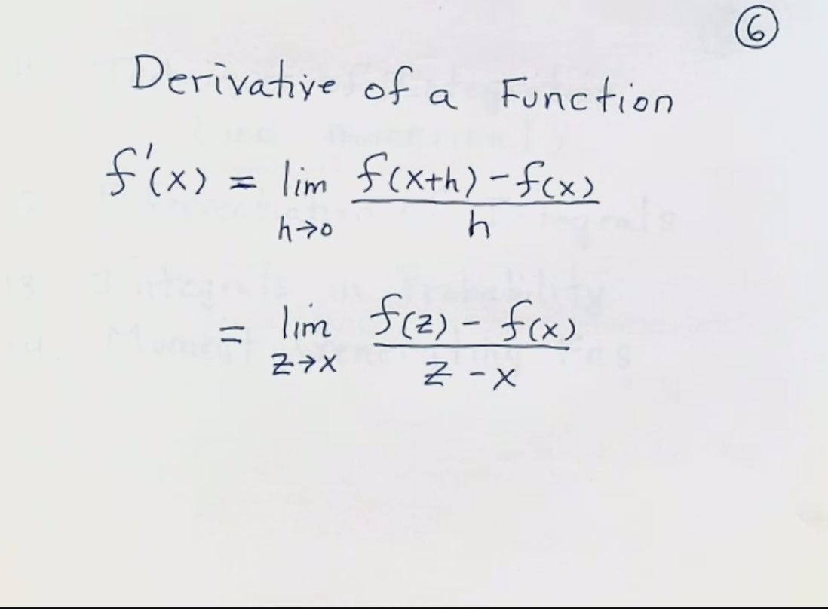
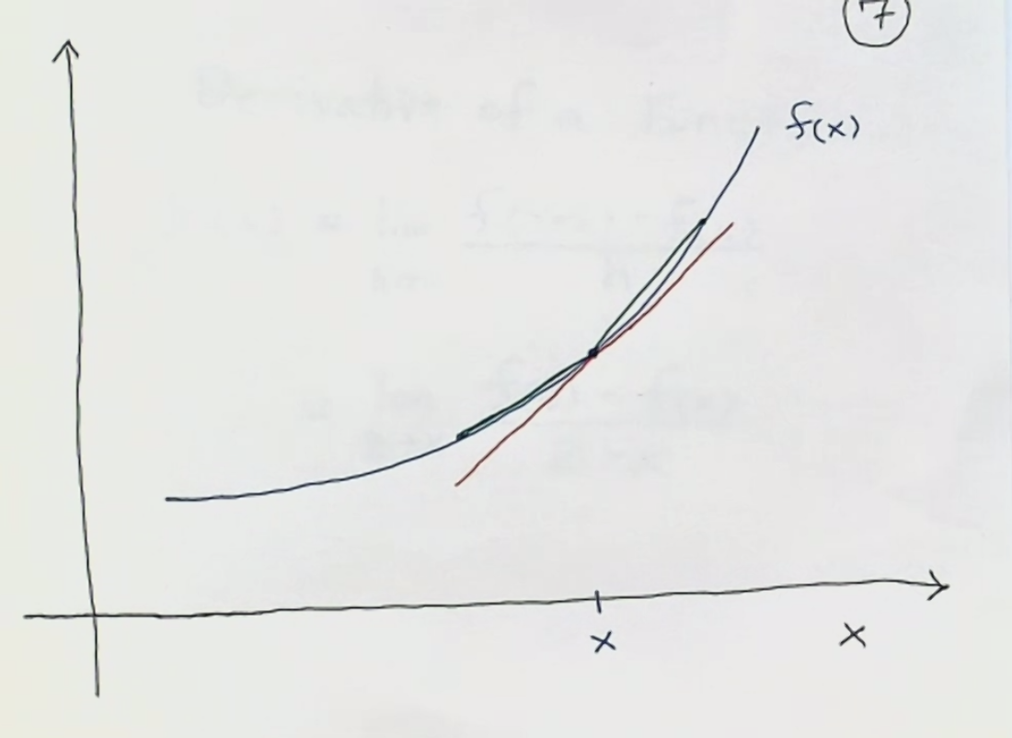

Slide 5
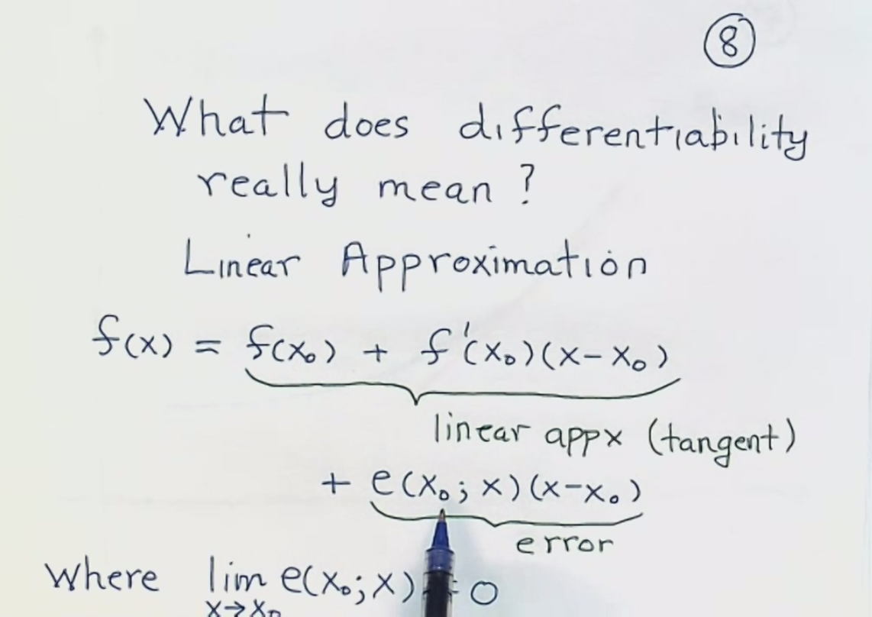
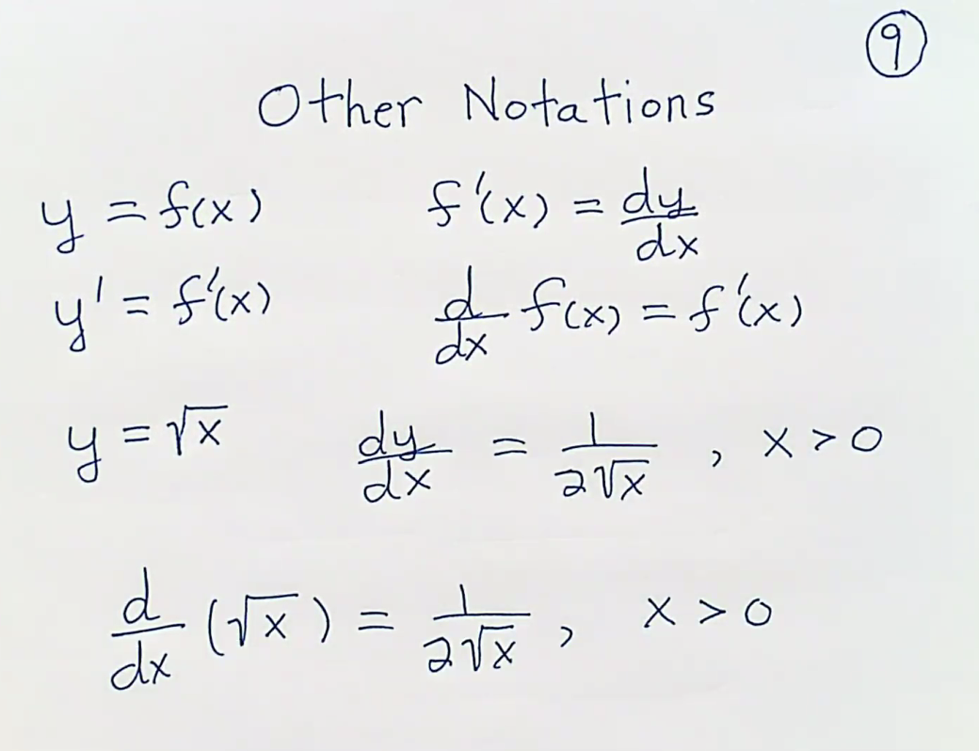

Slide 6
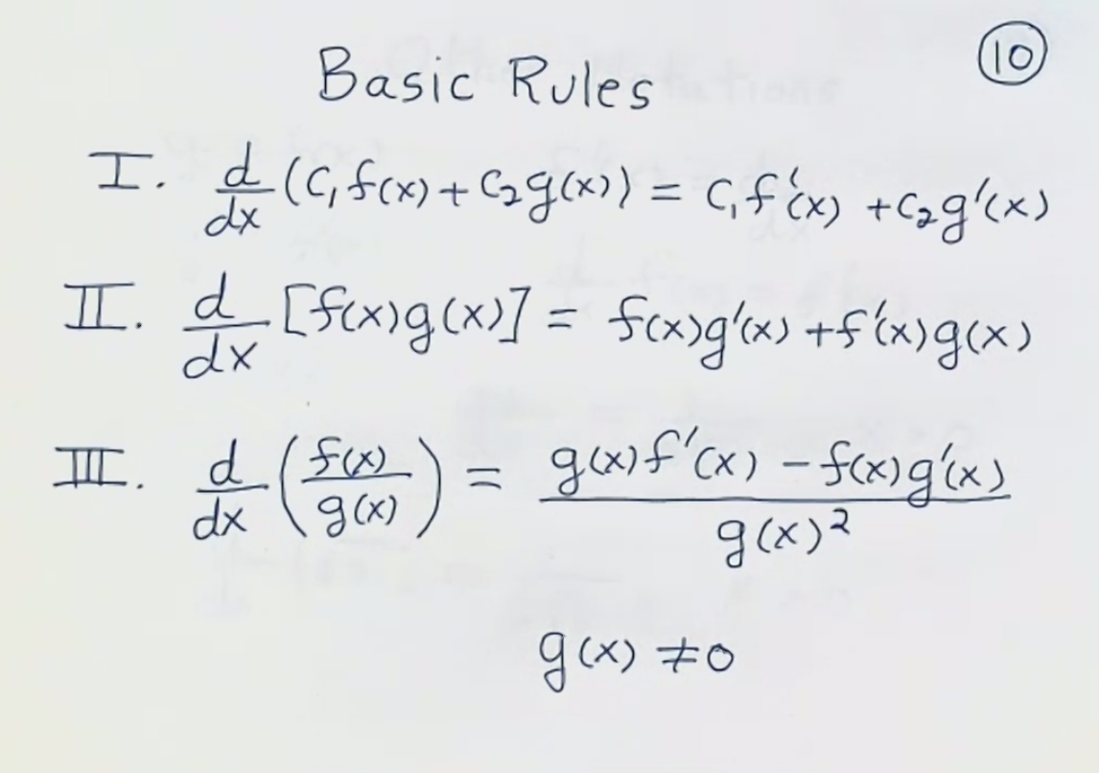
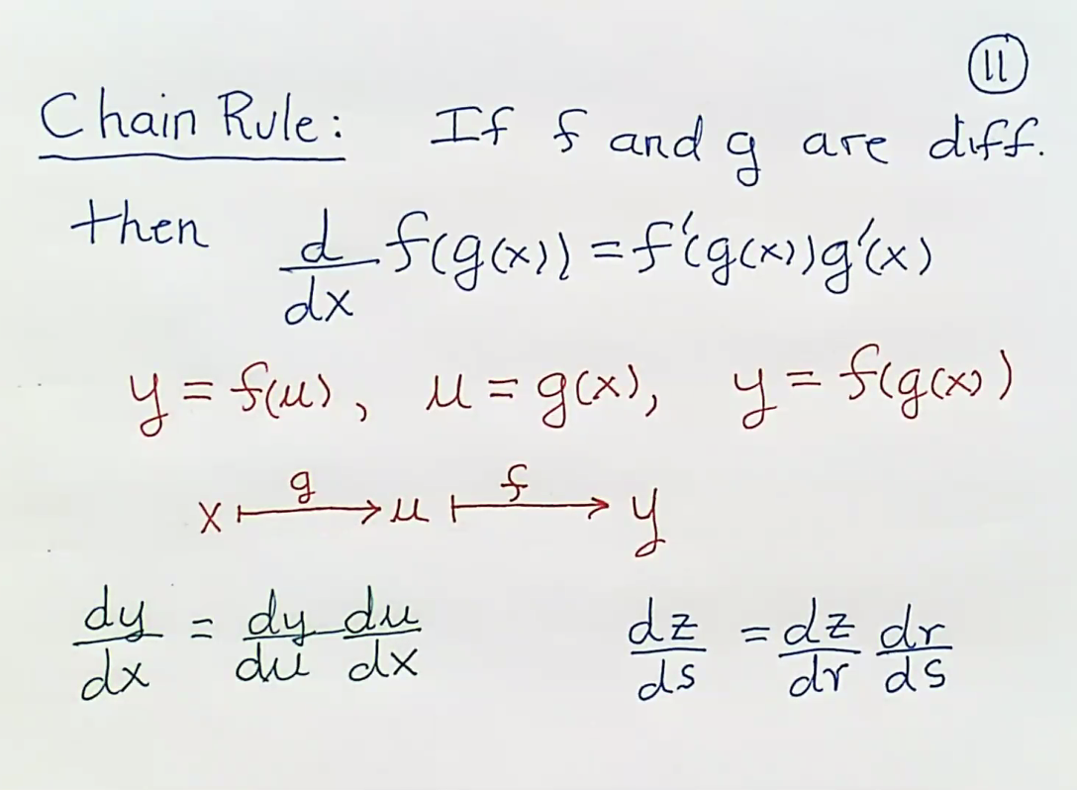

Slide 7
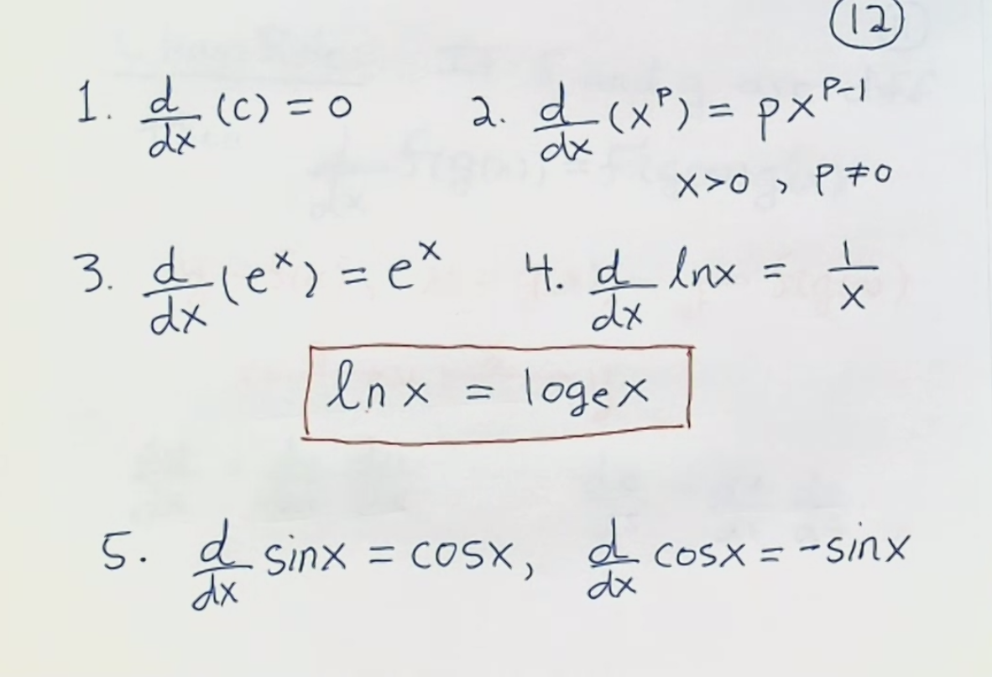
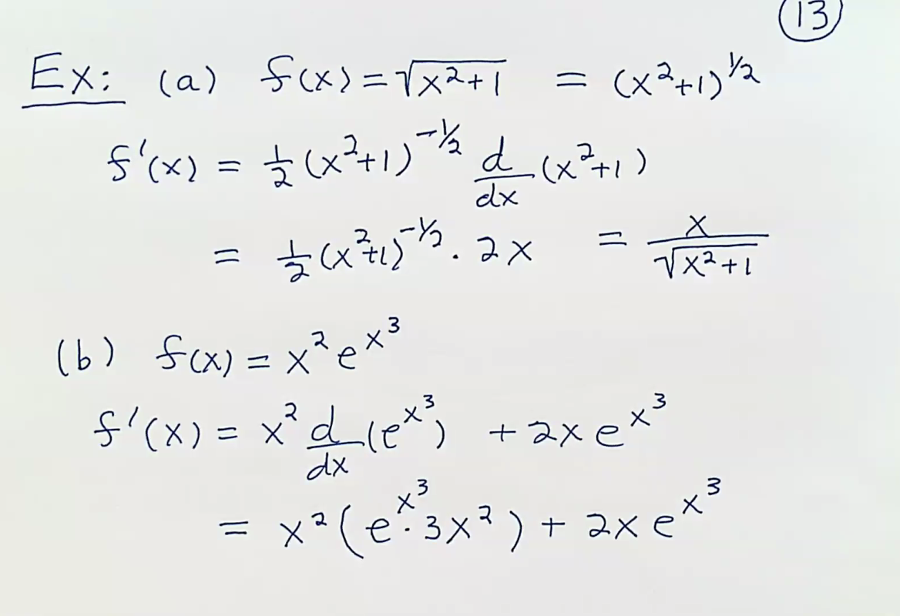

Slide 8
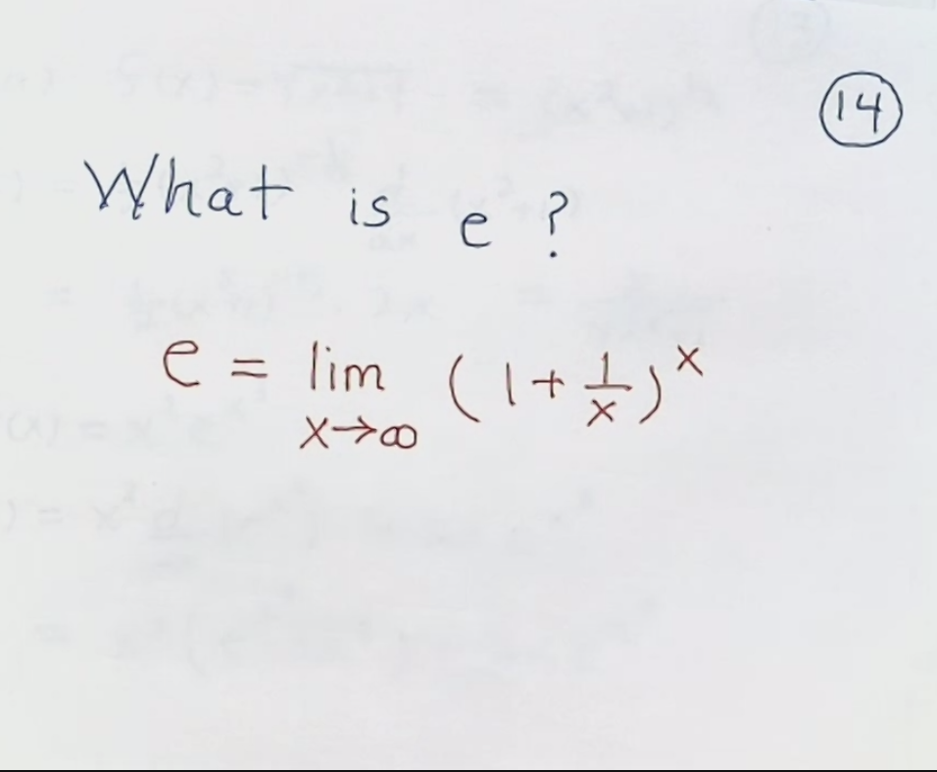
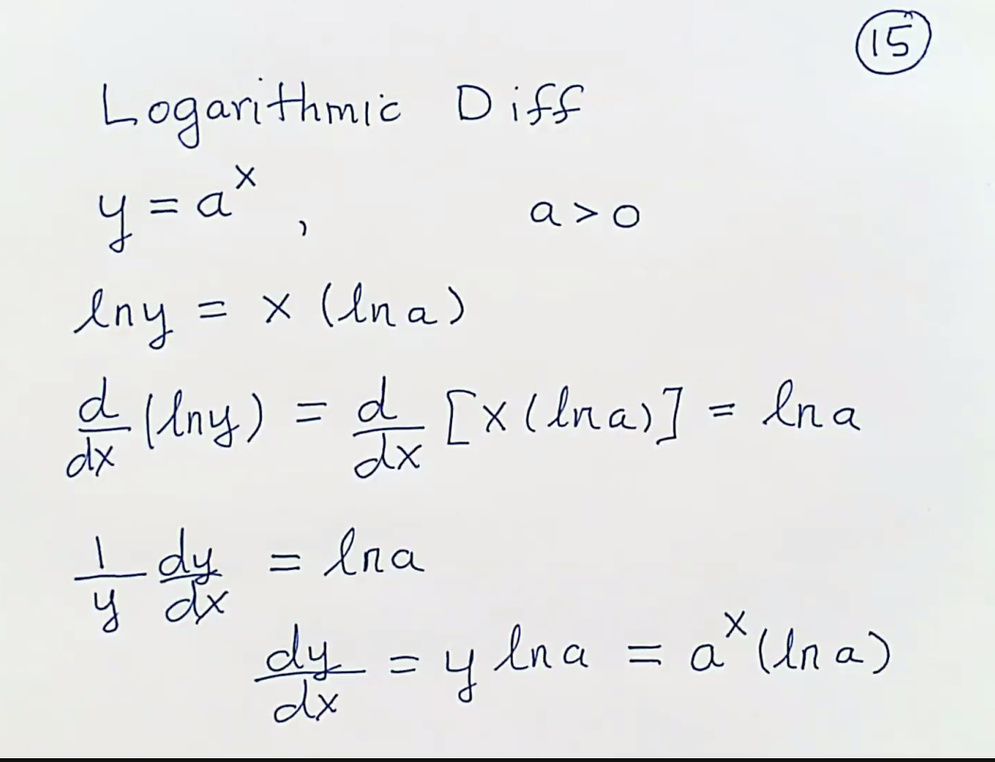

Slide 9
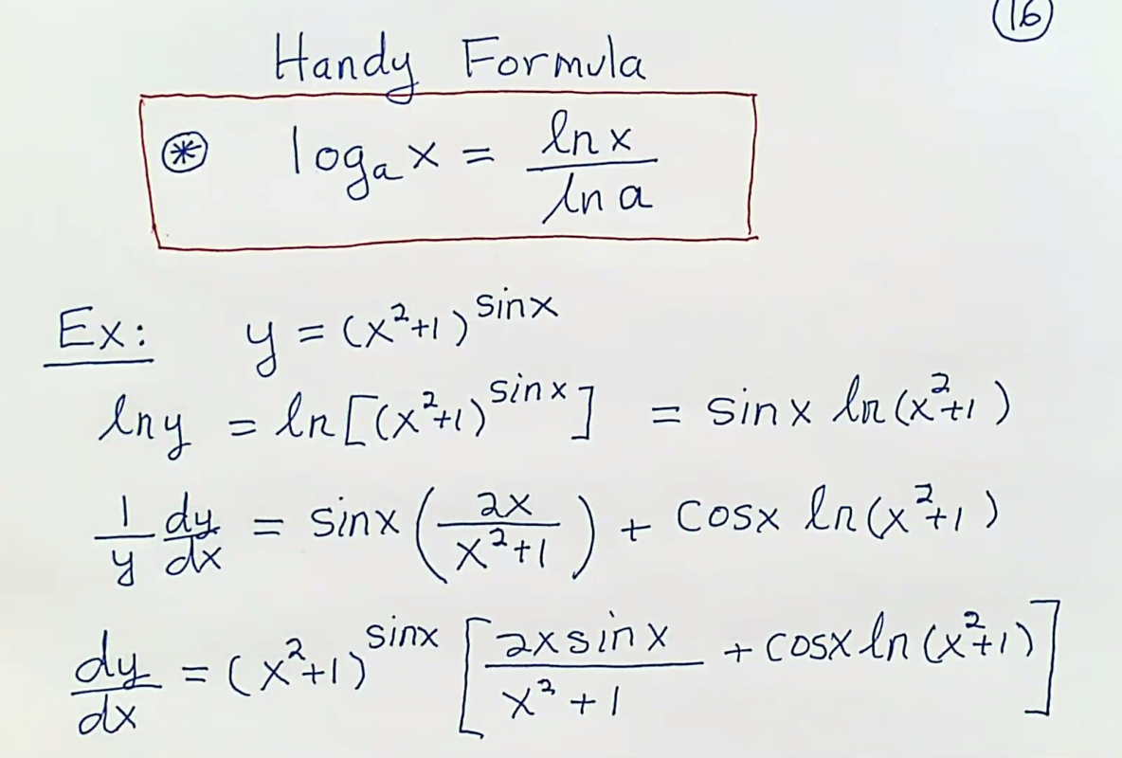
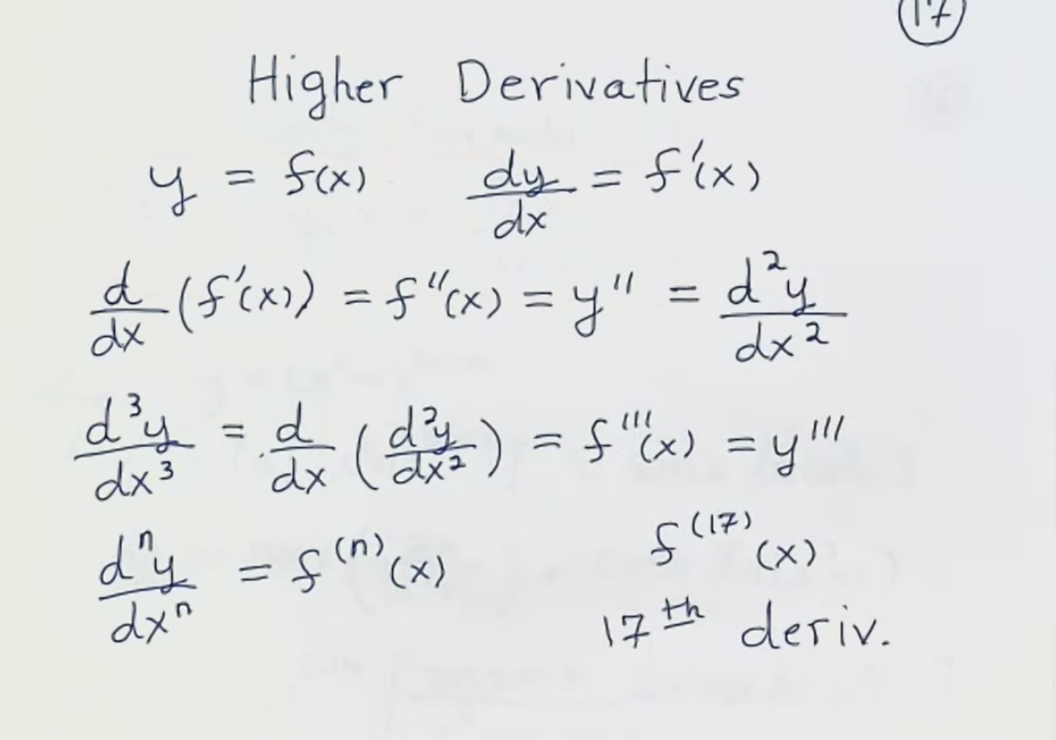

Slide 10
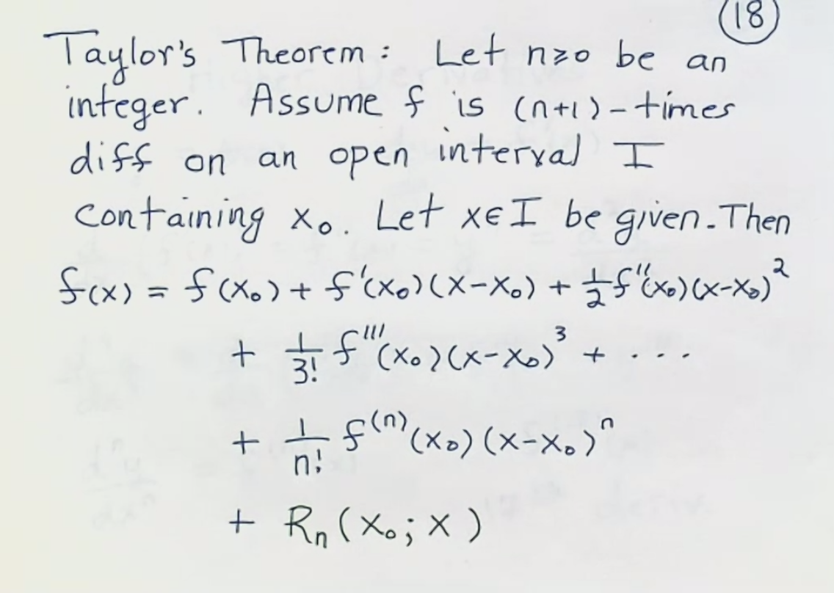
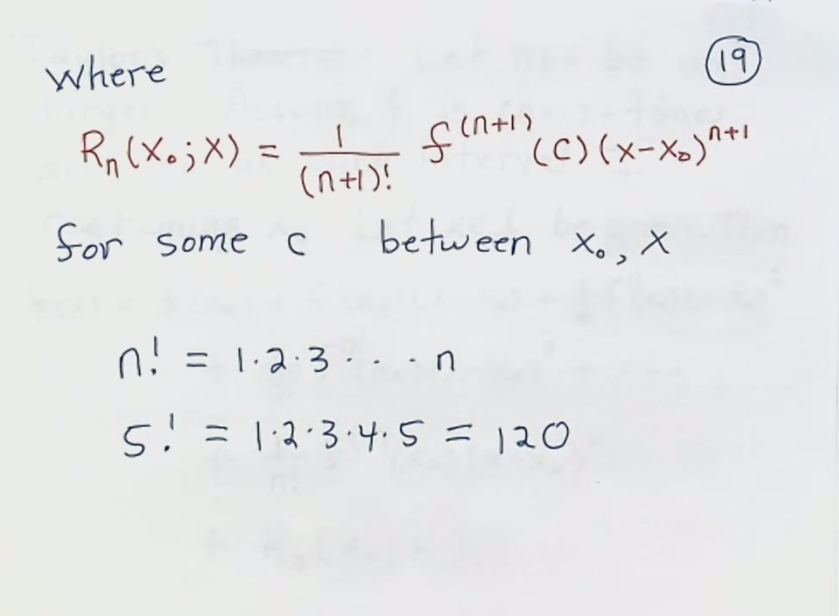

Slide 11
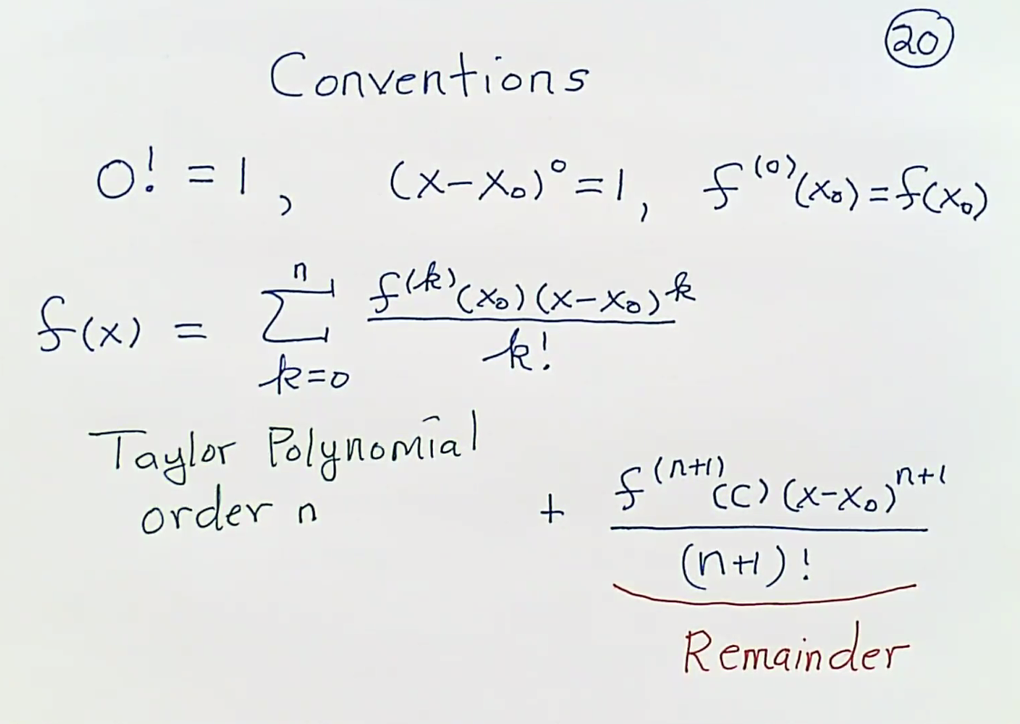
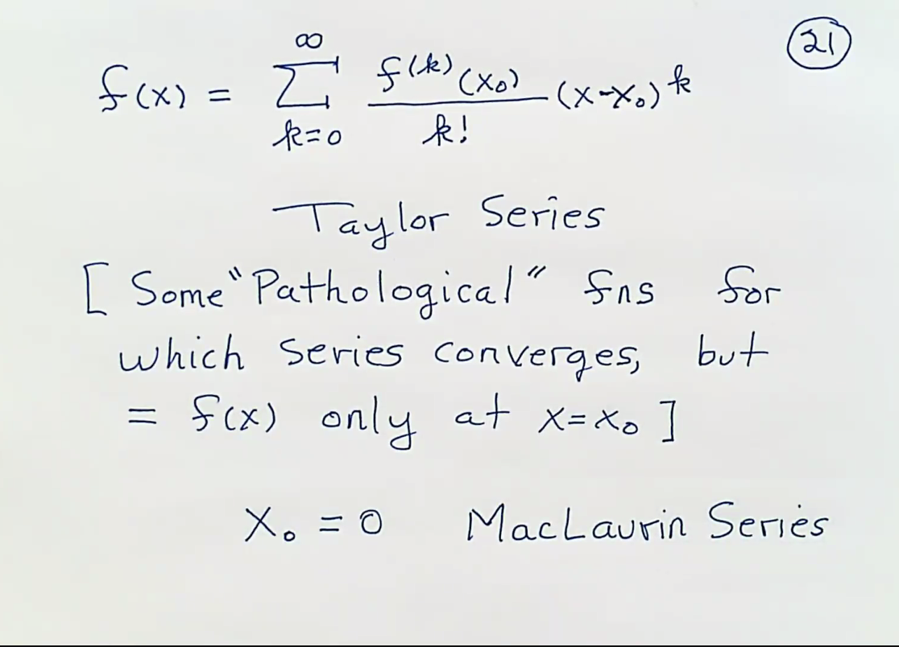

Slide 12
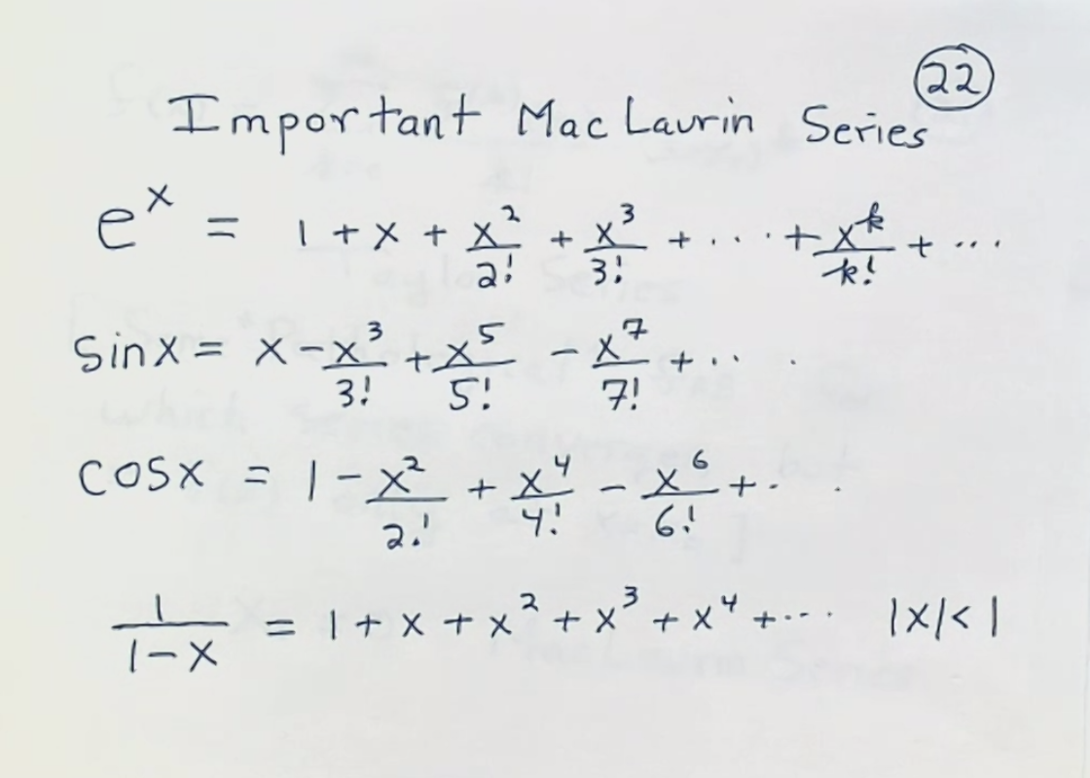
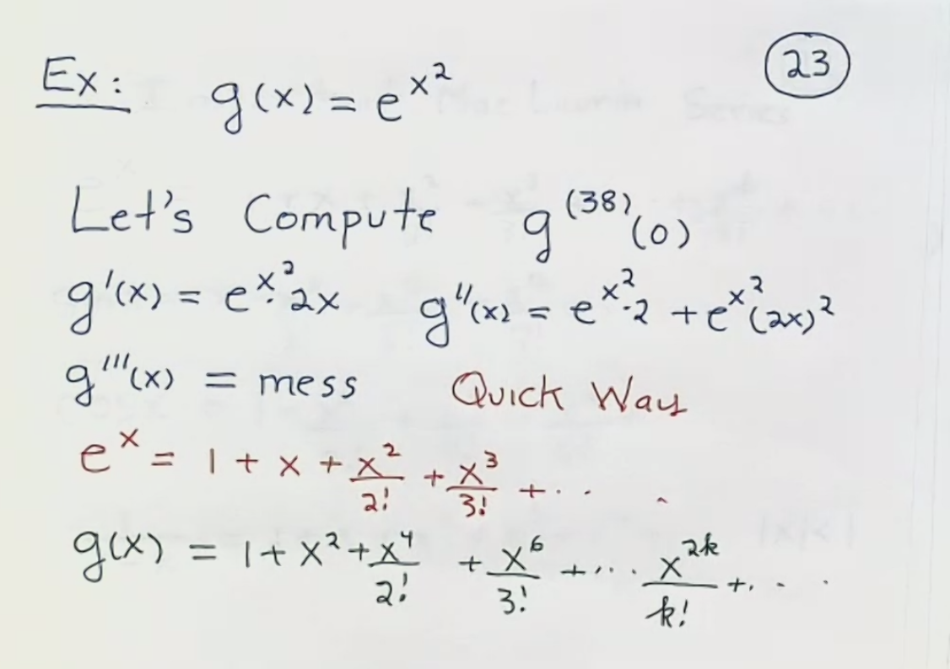
https://mathworld.wolfram.com/Integral.html
error term of taylor series https://secure.math.ubc.ca/~CLP/CLP1/clp_1_dc/ssec_taylor_error.html
https://en.wikipedia.org/wiki/Taylor_series
https://www.math24.net/taylor-maclaurin-series

Slide 13
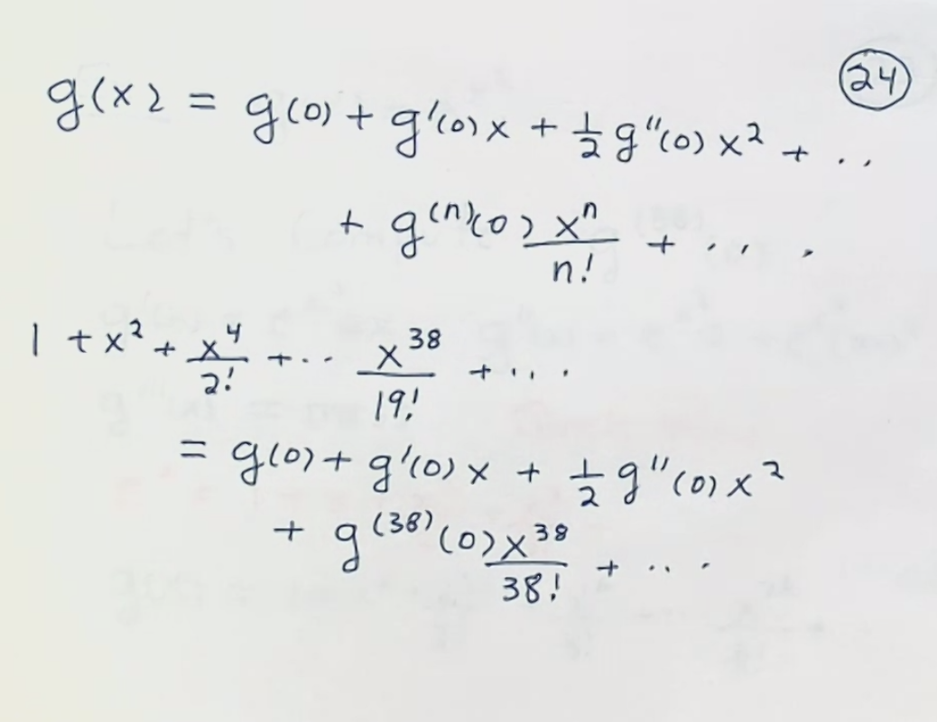
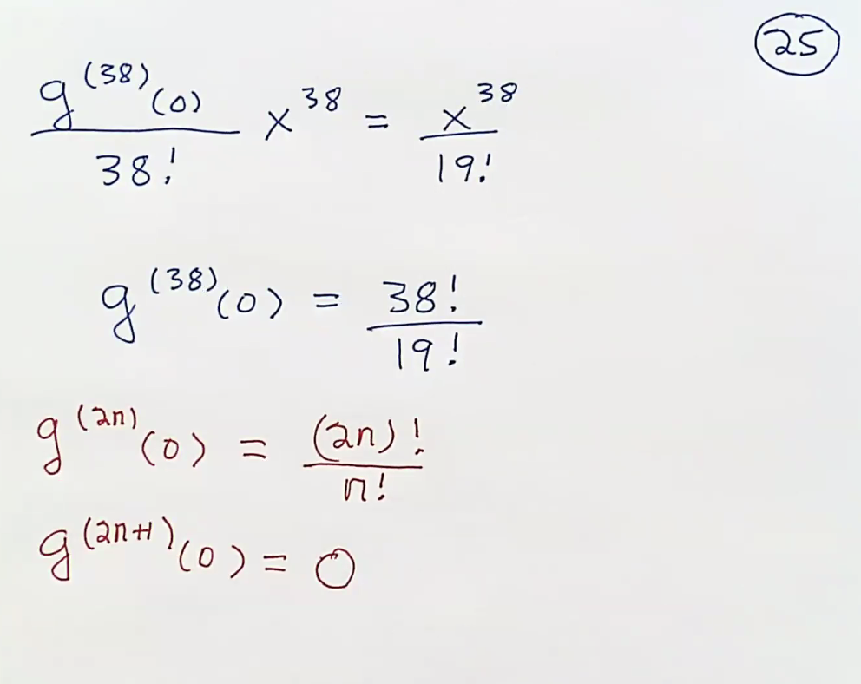
Differentiability, https://ocw.mit.edu/courses/mathematics/18-02sc-multivariable-calculus-fall-2010/syllabus/
https://ocw.mit.edu/courses/mathematics/18-01sc-single-variable-calculus-fall-2010/unit-2-applications-of-differentiation/part-c-mean-value-theorem-antiderivatives-and-differential-equations/session-35-using-the-mean-value-theorem/
https://en.wikipedia.org/wiki/Logarithmic_differentiation
What is e?

